Slide 1
Lesson 1 Pierre

Slide 2
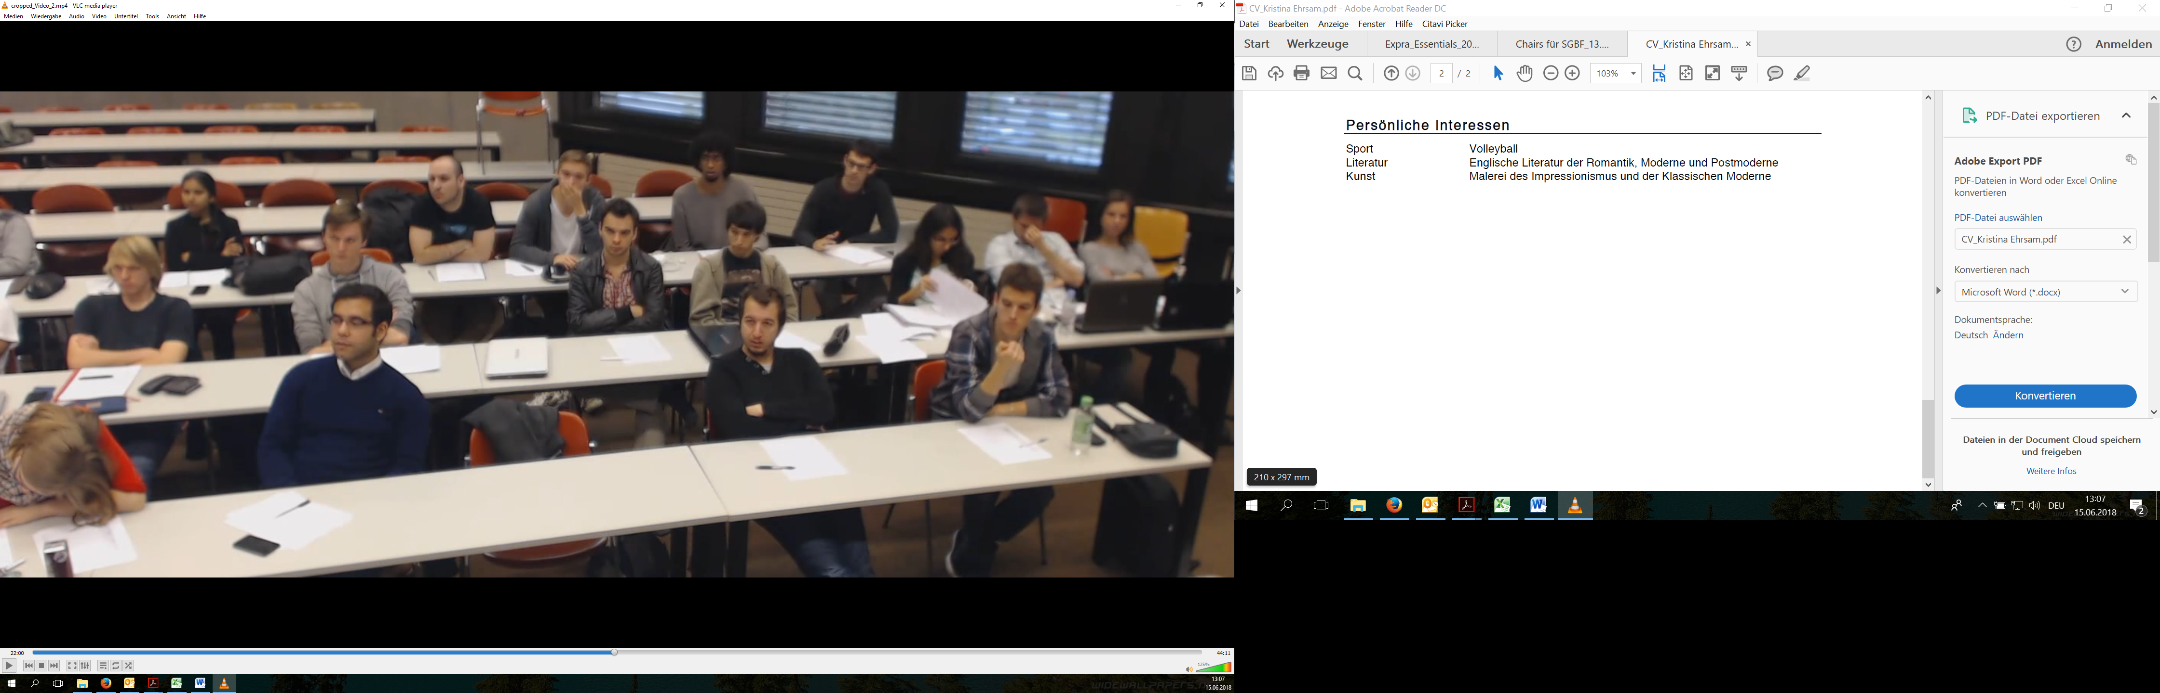
Cam 1 – Lesson 1 Pierre
107
76
75
94
101
104
106
112
79
71

Slide 3
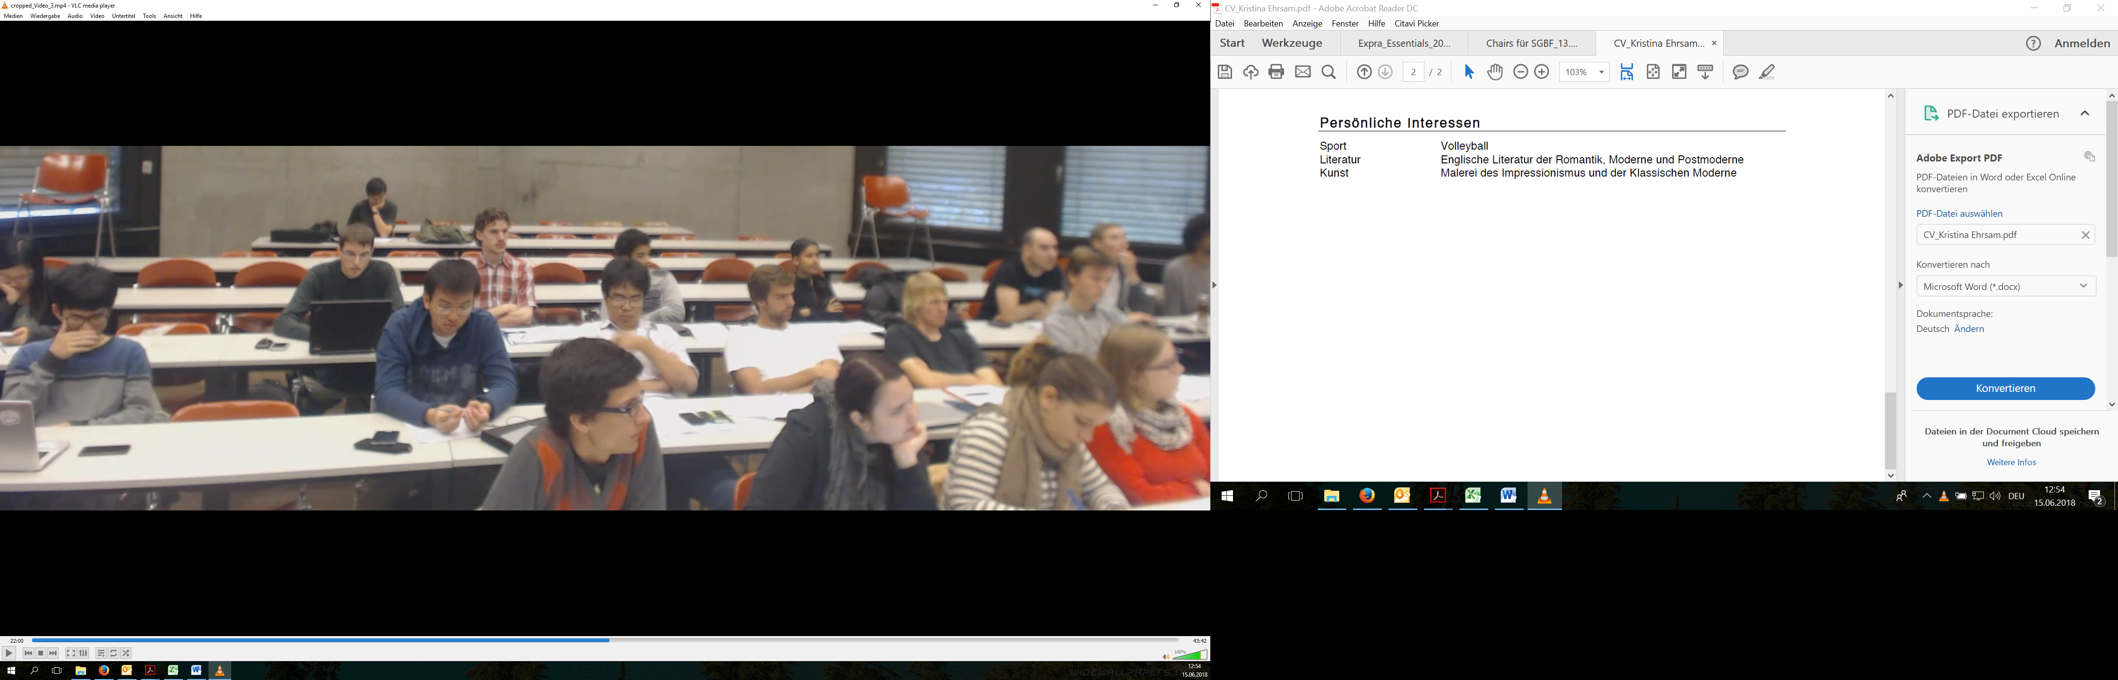
Cam 2 – Lesson 1 Pierre
116
85
95
90
74

Slide 4
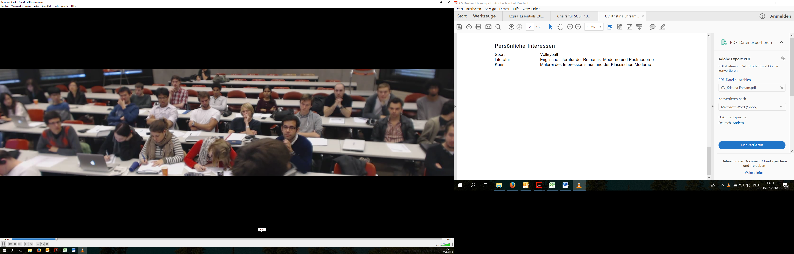
Cam 3 – Lesson 1 Pierre
109
77
81
84
111
98
115
78

Slide 5
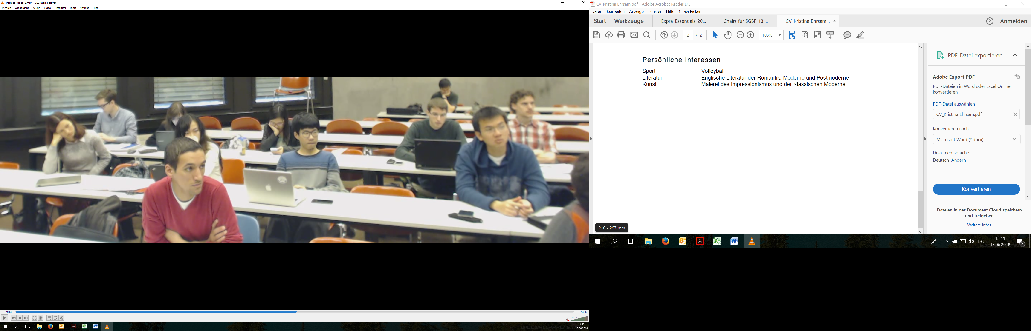
Cam 4 – Lesson 1 Pierre
105
93

